Slide 1
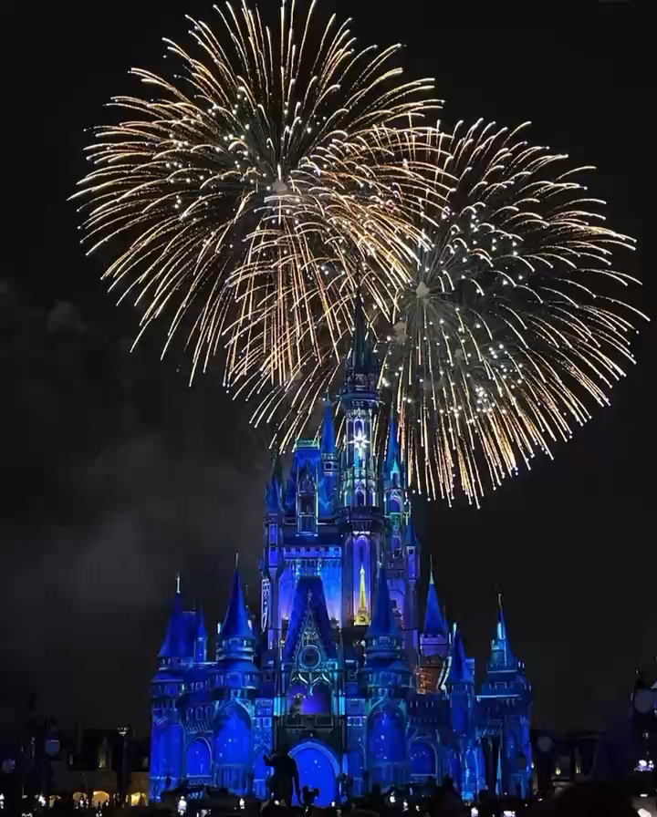
Orlando Resort Data Support and Service Solutions
Market positioning and implementation
Notes:
SOCIAL MEDIA MARKETING
Social media feeds: Regularly repost guest photos and videos on your hotel's Instagram, Facebook, or TikTok accounts.
UGC:
Create Shareable Moments: Design Instagrammable spots within the hotel, such as themed rooms, unique decor, or stunning views.
Offer Incentives: Provide small rewards like discounts, complimentary drinks, or loyalty points for guests who share their stay on social media with a branded hashtag.
TAILOR MARKETING EFFORTS
Microtargeting: As businesses aim to personalize their marketing efforts, microtargeting has become a key trend in market research in Orlando. This strategy involves collecting detailed data to segment potential customers into smaller, more specific groups, allowing businesses to tailor their messaging and offerings to meet the unique needs of each segment. For example: international travelers can be further segmented to:
Cultural Explorers: Travelers from Europe or Asia seeking immersive experiences.
Market proximity to cultural landmarks, museums, and authentic local cuisine.
Budget-Conscious Backpackers: Younger international visitors looking for affordable stays.
Promote shared rooms, discounts for extended stays, and local transportation deals.
Luxury Travelers: High-income individuals seeking exclusivity and top-notch services.
Showcase high-end suites, concierge services, and private tours.
Frequent Business Travelers: Professionals who combine business and leisure (bleisure).
Highlight work-friendly amenities and quick access to key business districts.
Encourage Guests to Share Experiences
Create Shareable Moments: Design Instagrammable spots within the hotel, such as themed rooms, unique decor, or stunning views.
Offer Incentives: Provide small rewards like discounts, complimentary drinks, or loyalty points for guests who share their stay on social media with a branded hashtag.
Social Media Feeds: Regularly repost guest photos and videos on your hotel's Instagram, Facebook, or TikTok accounts.Highlight different experiences (e.g., dining, spa, pet-friendly features).
Website Integration: Display UGC galleries on your hotel’s website to show authentic guest experiences.Use tools like "Social Wall" to aggregate tagged posts.
Customer Experience Research
Social Media Listening:Monitor platforms like Twitter or Instagram for customer sentiment and feedback.
Touchpoint-Specific Surveys:Trigger surveys immediately after a customer interaction (e.g., after a hotel stay or call center interaction).
Identify gaps between customer expectations and actual experiences.
Installing kiosks (a small, self-service station or booth, typically equipped with a touchscreen, that allows customers to interact with a system to perform specific tasks) in physical locations(e.g., hotel lobby) allows customers to quickly rate their experience or answer specific questions.

Slide 2
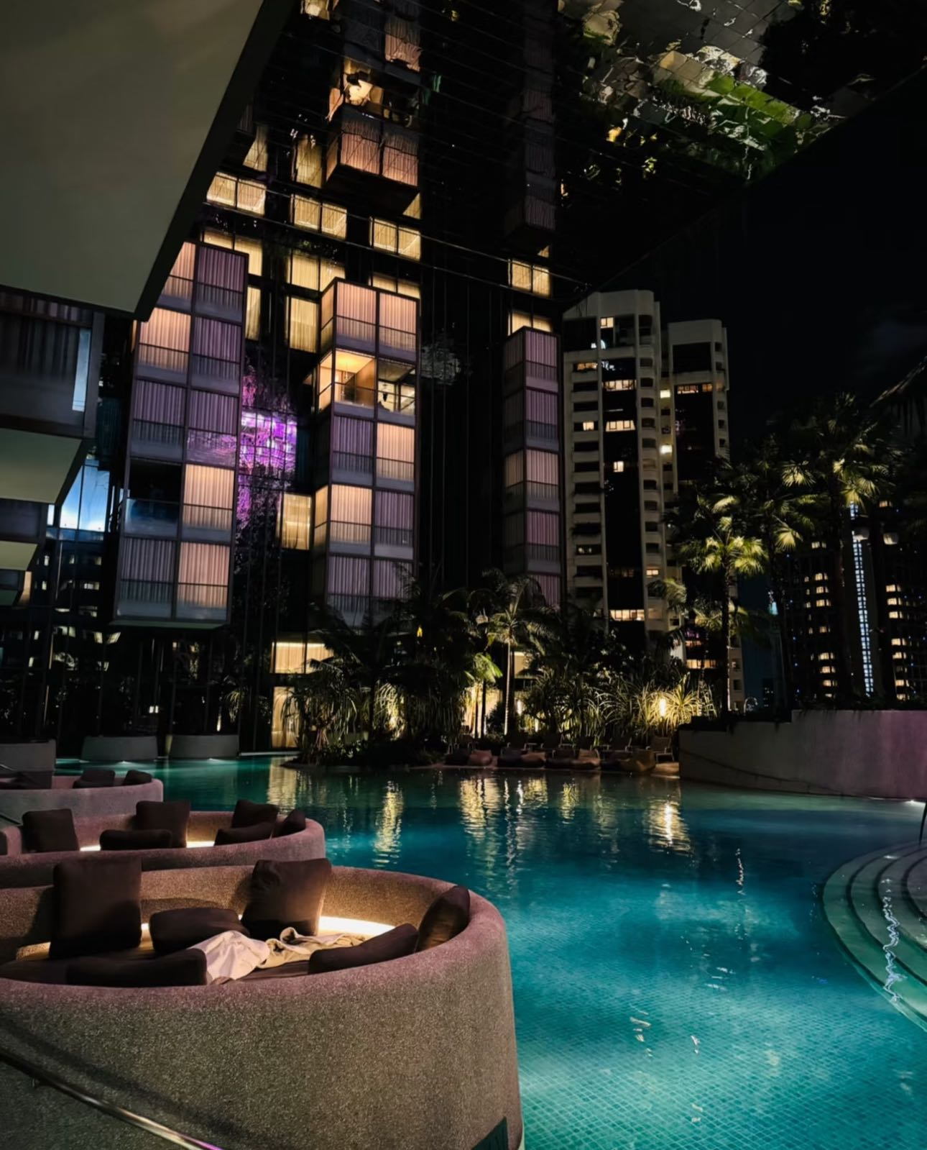
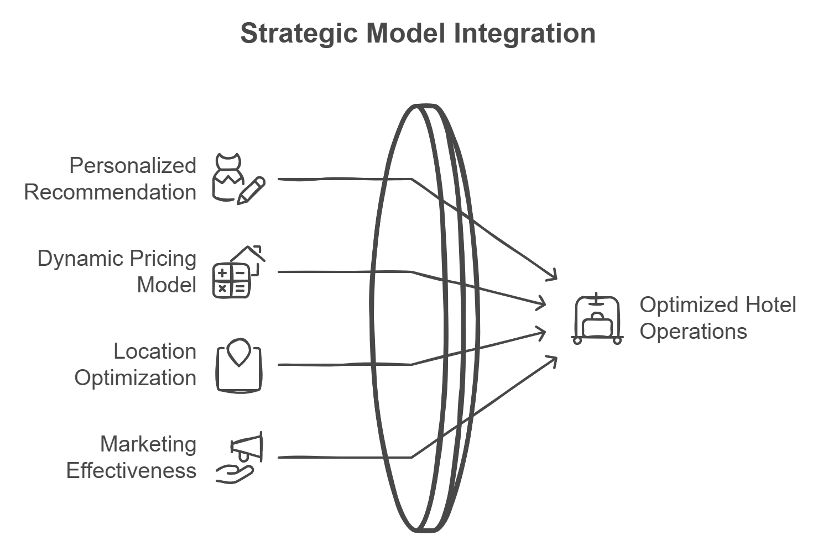
Data Product Pipeline
Notes:
Models and Algorithms
• Product:
• Personalized recommendation: Deliver the most suitable room types, packages and services based on your unique preferences and needs.
• Price:
• Dynamic Pricing Model: Predict the impact of different price points on occupancy rates and revenue.
• Place:
• Location Optimization Model: Recommend the best hotel locations based on traffic, competitor distribution, and customer behavior.
• Promotion:
• Marketing Effectiveness Model: Predict the impact of promotional activities on booking volume.

Slide 3
01
Product

Slide 4
01
Product
02
Place

Slide 5
01
Product
02
Place
03
Price

Slide 6
01
Product
02
Place
03
Price
04
Promotion

Slide 7
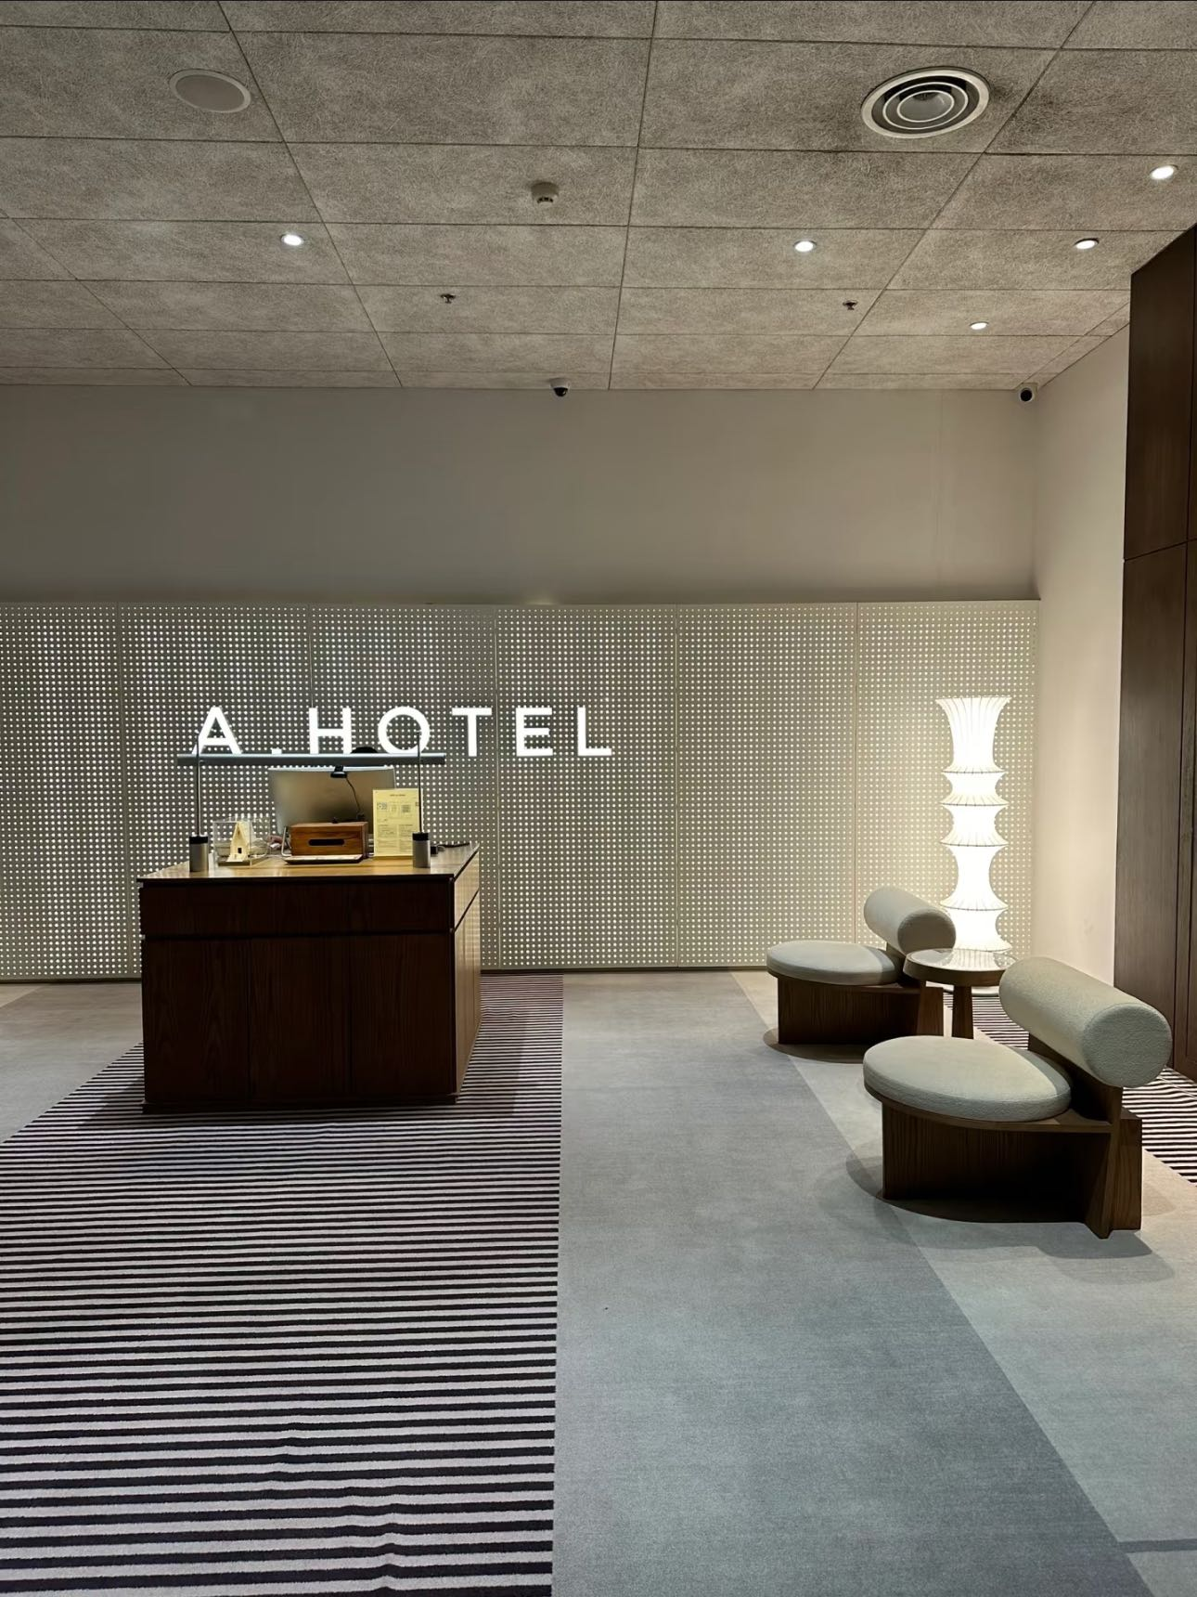
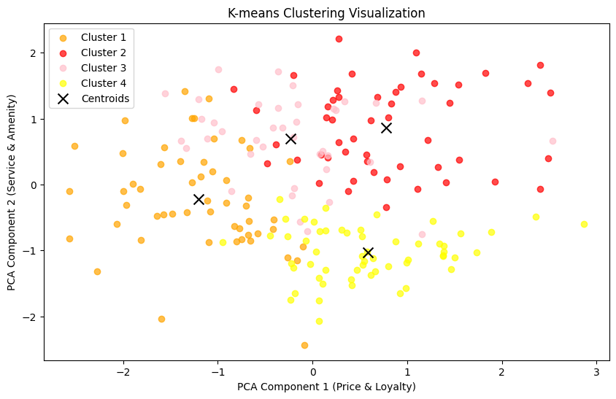
K-means Clustering
Orange (Cluster 1):
Lowest on both price-loyalty and service-amenity demands.
Dark Red (Cluster 2):
High price and loyalty, with equally high demands for service and amenities.2.
Pink (Cluster 3):
Focuses on experience (high on the vertical axis) with medium price and loyalty.
Yellow (Cluster 4):
Lowest demand for service and amenities but relatively high price and loyalty.4.
Notes:
SOCIAL MEDIA MARKETING
Social media feeds: Regularly repost guest photos and videos on your hotel's Instagram, Facebook, or TikTok accounts.
UGC:
Create Shareable Moments: Design Instagrammable spots within the hotel, such as themed rooms, unique decor, or stunning views.
Offer Incentives: Provide small rewards like discounts, complimentary drinks, or loyalty points for guests who share their stay on social media with a branded hashtag.
TAILOR MARKETING EFFORTS
Microtargeting: As businesses aim to personalize their marketing efforts, microtargeting has become a key trend in market research in Orlando. This strategy involves collecting detailed data to segment potential customers into smaller, more specific groups, allowing businesses to tailor their messaging and offerings to meet the unique needs of each segment. For example: international travelers can be further segmented to:
Cultural Explorers: Travelers from Europe or Asia seeking immersive experiences.
Market proximity to cultural landmarks, museums, and authentic local cuisine.
Budget-Conscious Backpackers: Younger international visitors looking for affordable stays.
Promote shared rooms, discounts for extended stays, and local transportation deals.
Luxury Travelers: High-income individuals seeking exclusivity and top-notch services.
Showcase high-end suites, concierge services, and private tours.
Frequent Business Travelers: Professionals who combine business and leisure (bleisure).
Highlight work-friendly amenities and quick access to key business districts.
Encourage Guests to Share Experiences
Create Shareable Moments: Design Instagrammable spots within the hotel, such as themed rooms, unique decor, or stunning views.
Offer Incentives: Provide small rewards like discounts, complimentary drinks, or loyalty points for guests who share their stay on social media with a branded hashtag.
Social Media Feeds: Regularly repost guest photos and videos on your hotel's Instagram, Facebook, or TikTok accounts.Highlight different experiences (e.g., dining, spa, pet-friendly features).
Website Integration: Display UGC galleries on your hotel’s website to show authentic guest experiences.Use tools like "Social Wall" to aggregate tagged posts.
Customer Experience Research
Social Media Listening:Monitor platforms like Twitter or Instagram for customer sentiment and feedback.
Touchpoint-Specific Surveys:Trigger surveys immediately after a customer interaction (e.g., after a hotel stay or call center interaction).
Identify gaps between customer expectations and actual experiences.
Installing kiosks (a small, self-service station or booth, typically equipped with a touchscreen, that allows customers to interact with a system to perform specific tasks) in physical locations(e.g., hotel lobby) allows customers to quickly rate their experience or answer specific questions.

Slide 8
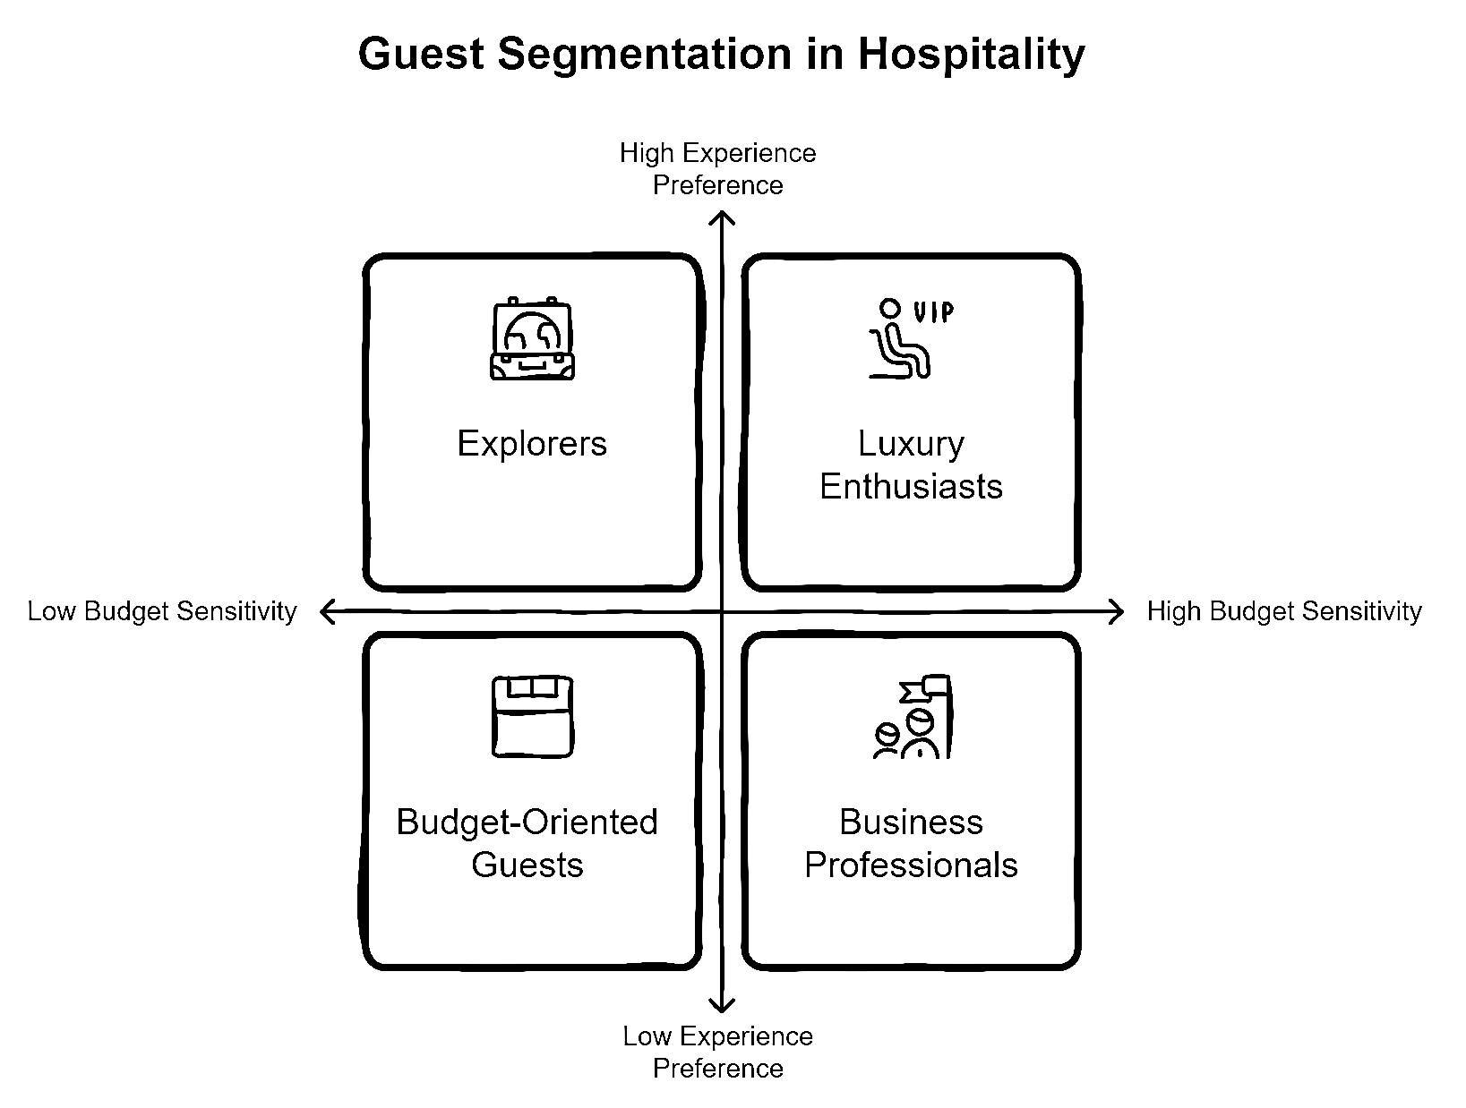
Who are our Target Customers
Notes:
SOCIAL MEDIA MARKETING
Social media feeds: Regularly repost guest photos and videos on your hotel's Instagram, Facebook, or TikTok accounts.
UGC:
Create Shareable Moments: Design Instagrammable spots within the hotel, such as themed rooms, unique decor, or stunning views.
Offer Incentives: Provide small rewards like discounts, complimentary drinks, or loyalty points for guests who share their stay on social media with a branded hashtag.
TAILOR MARKETING EFFORTS
Microtargeting: As businesses aim to personalize their marketing efforts, microtargeting has become a key trend in market research in Orlando. This strategy involves collecting detailed data to segment potential customers into smaller, more specific groups, allowing businesses to tailor their messaging and offerings to meet the unique needs of each segment. For example: international travelers can be further segmented to:
Cultural Explorers: Travelers from Europe or Asia seeking immersive experiences.
Market proximity to cultural landmarks, museums, and authentic local cuisine.
Budget-Conscious Backpackers: Younger international visitors looking for affordable stays.
Promote shared rooms, discounts for extended stays, and local transportation deals.
Luxury Travelers: High-income individuals seeking exclusivity and top-notch services.
Showcase high-end suites, concierge services, and private tours.
Frequent Business Travelers: Professionals who combine business and leisure (bleisure).
Highlight work-friendly amenities and quick access to key business districts.
Encourage Guests to Share Experiences
Create Shareable Moments: Design Instagrammable spots within the hotel, such as themed rooms, unique decor, or stunning views.
Offer Incentives: Provide small rewards like discounts, complimentary drinks, or loyalty points for guests who share their stay on social media with a branded hashtag.
Social Media Feeds: Regularly repost guest photos and videos on your hotel's Instagram, Facebook, or TikTok accounts.Highlight different experiences (e.g., dining, spa, pet-friendly features).
Website Integration: Display UGC galleries on your hotel’s website to show authentic guest experiences.Use tools like "Social Wall" to aggregate tagged posts.
Customer Experience Research
Social Media Listening:Monitor platforms like Twitter or Instagram for customer sentiment and feedback.
Touchpoint-Specific Surveys:Trigger surveys immediately after a customer interaction (e.g., after a hotel stay or call center interaction).
Identify gaps between customer expectations and actual experiences.
Installing kiosks (a small, self-service station or booth, typically equipped with a touchscreen, that allows customers to interact with a system to perform specific tasks) in physical locations(e.g., hotel lobby) allows customers to quickly rate their experience or answer specific questions.

Slide 9
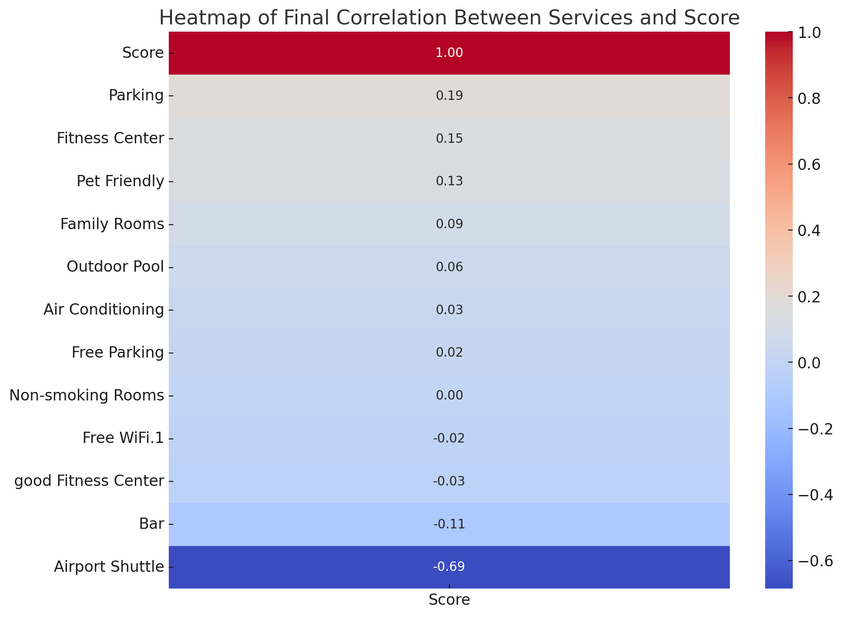
Product
Notes:
Let’s take a deeper look at the 'Product'
what services we should equip with to meet the needs of our target customers
we analyzed data from existing hotels in Orlando Since we are planning to open a family-oriented resort, I filtered the data for resort hotels. Iso this heat map shows the correlation between different services and the overall scores of resorts.
From thiswe can see that services like Parking, Fitness Centers, and Pet-Friendly policies have relatively high positive correlations with customer satisfaction. These indicate that families might find essential for convenience and comfort with these services. On the other hand, services like Airport Shuttles and Bars have negative correlations, which suggests they may be less important for family-oriented resorts so we might not consider.

Slide 10
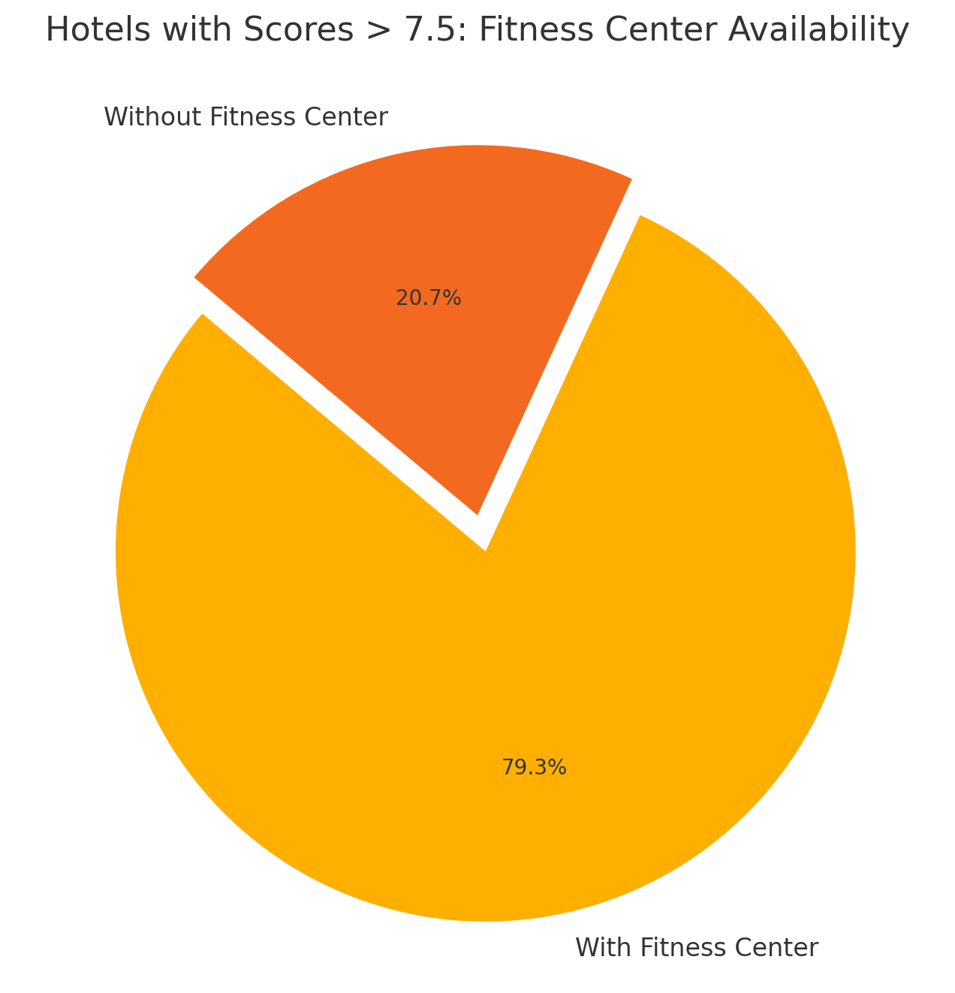

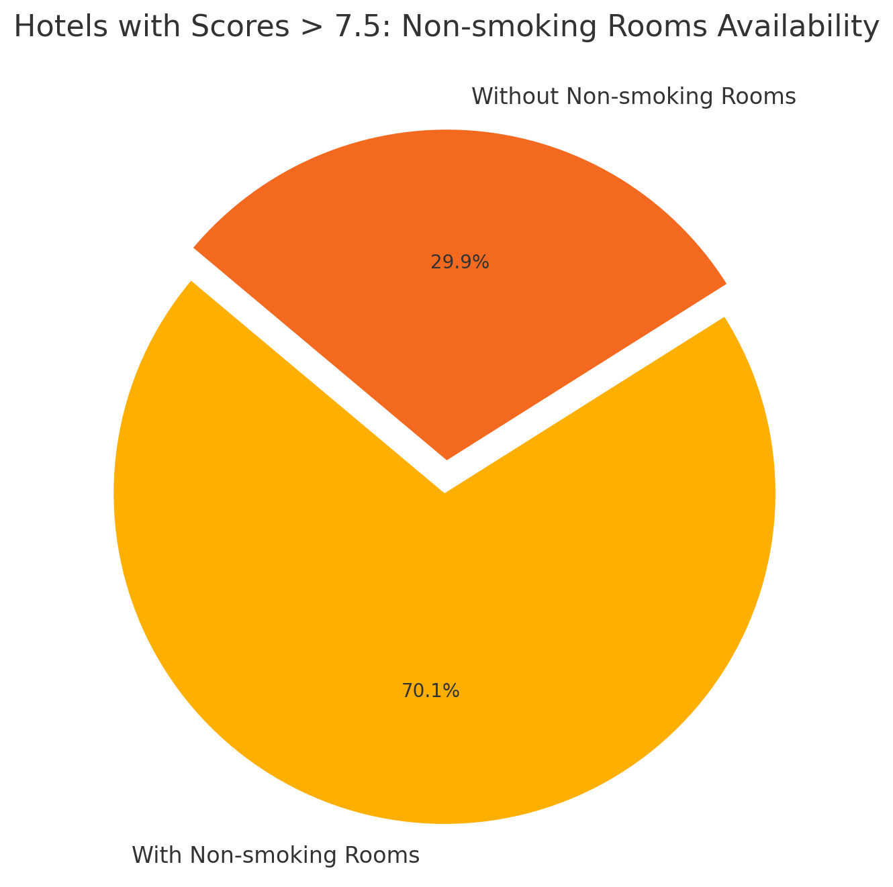
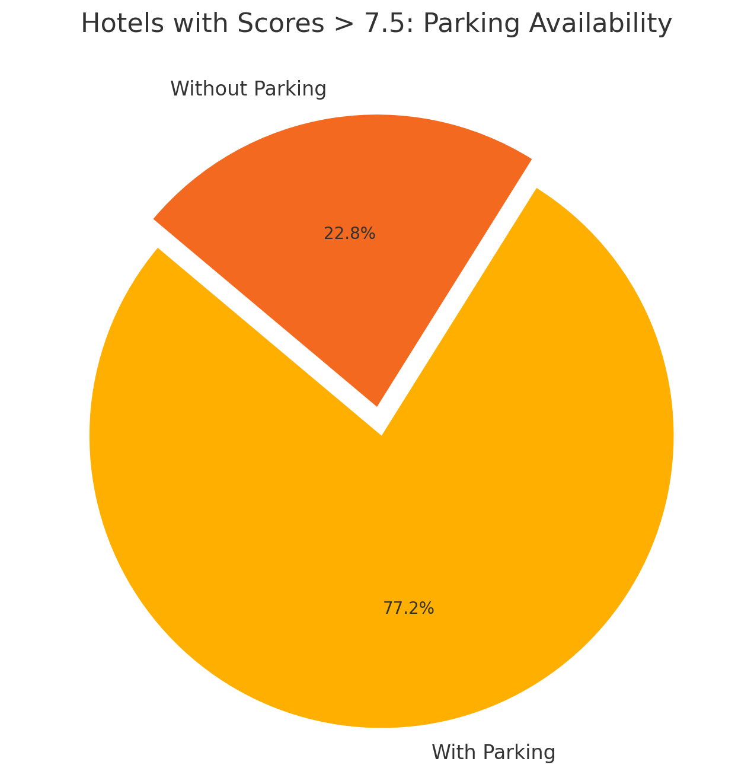
Product
Fitness Center
Pet-Friendly
Non-smoking rooms
Parking Lots
Notes:
After correlation analysis, we take a closer look at what services do the good hotels equipped with? So we filtered the hotels with overall score higher than 7.5 and see
From these pie charts, we see that high-rated hotels often include key amenities such as Fitness Centers (79.1%), Parking (77.7%), and Family Rooms (67.6%), This tells us that these services are important for high-rated hotels and should be included in our resort to meet customer expectations

Slide 11
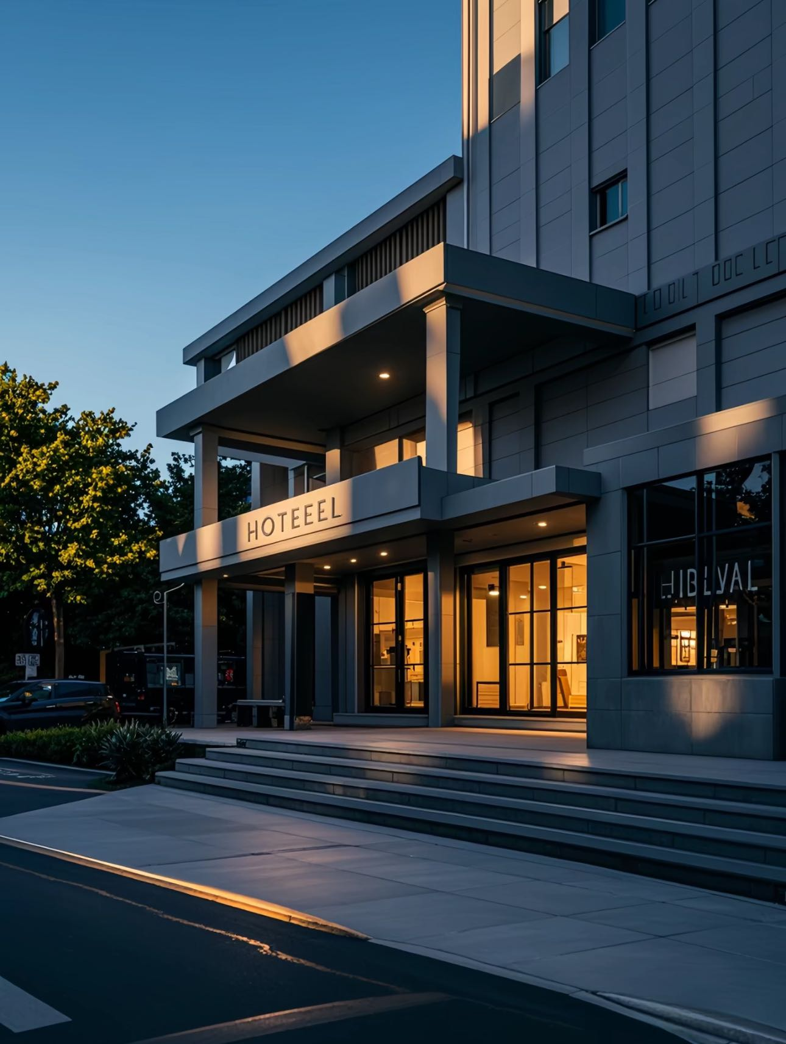
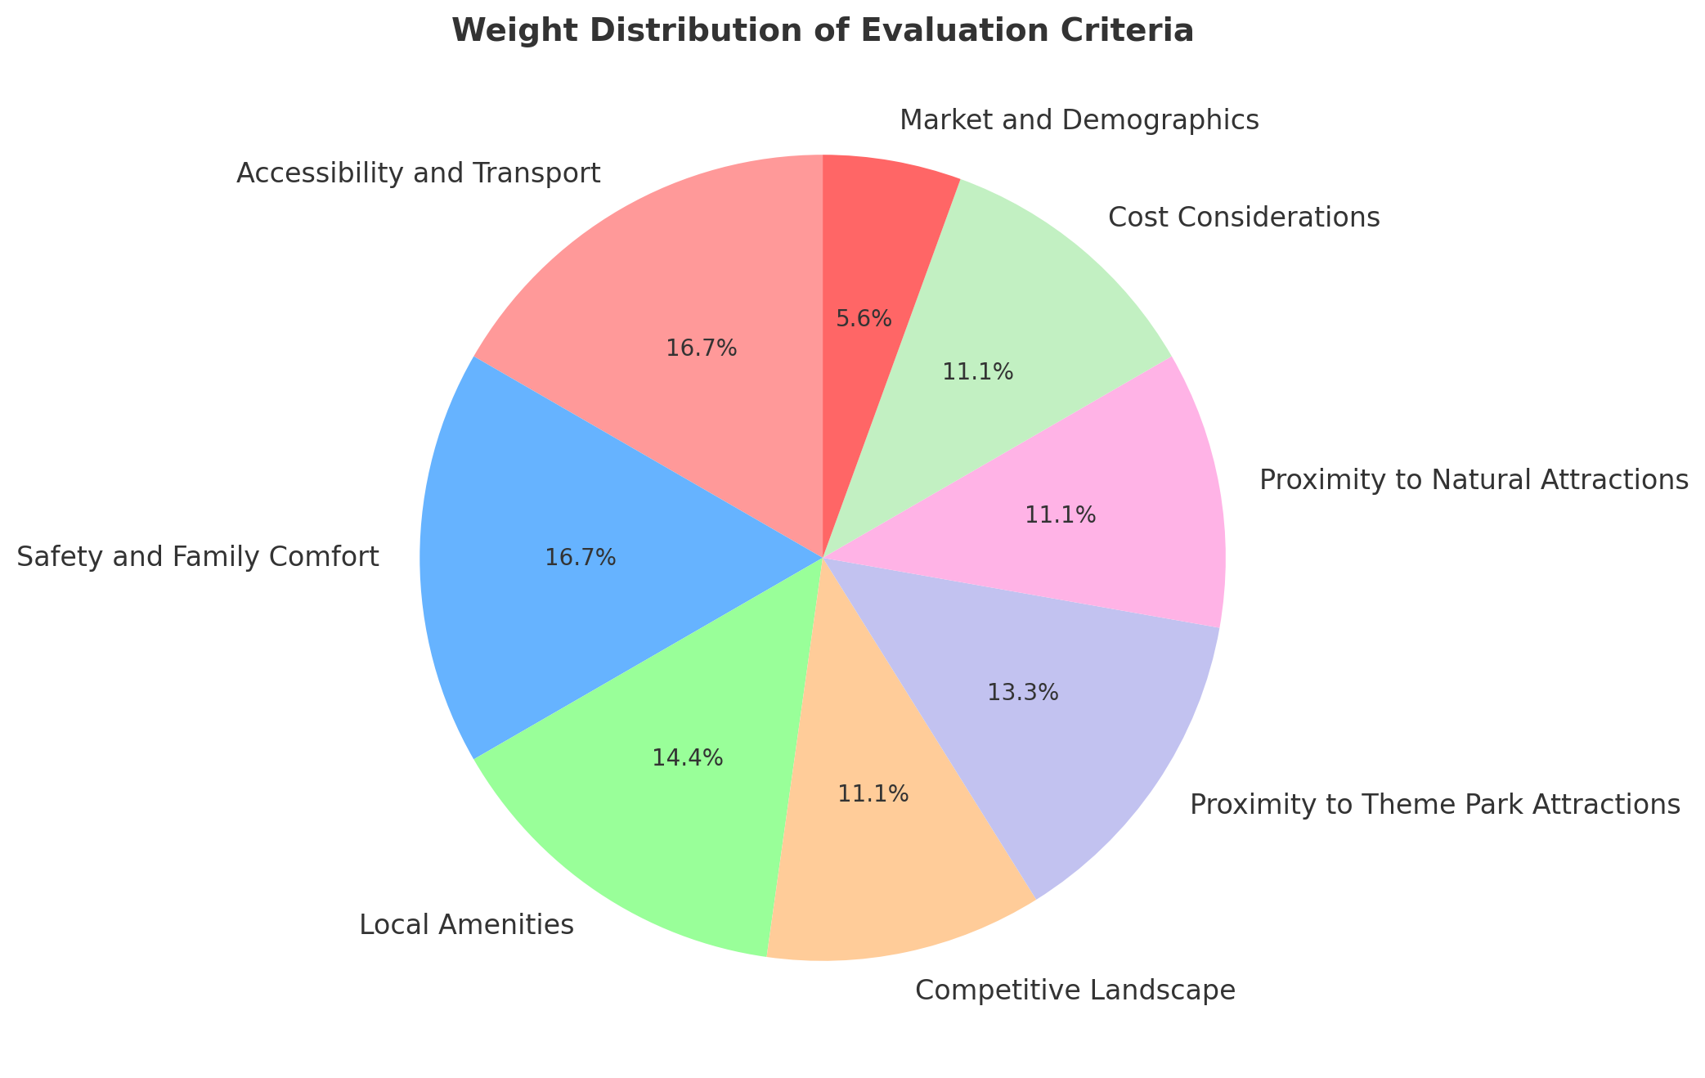
Evaluation Criteria Comparison
Hotel location evaluation system Accessibility and Transport (15)
Shuttle Service Feasibility (7)
Proximity to Major Roads (5)
Traffic Conditions (3)
Safety and Family Comfort (15)
Crime Rate (10)
Neighborhood Appeal (5)
Local Amenities (13)
Family-Friendly Restaurants (5)
Retail and Grocery Stores (5)
Medical Facilities (3)
Competitive Landscape (10)
Number of Nearby Hotels (5)
Competitor Pricing (3)
Competitor Amenities (2)
Proximity to Theme Park Attractions (12)
Distance to Major Parks (12)
Proximity to Natural Attractions (10)
Distance to Parks or Lakes (6)
Scenic Value (4)
Cost Considerations (10)
Property Prices (5)
Operational Costs (3)
Taxes and Fees (2)
Market and Demographics (5)
Family Tourism Demand (3)
Population Growth (2)
Notes:
Next let’s dive into next aspect, place, to analyze this , we created our own hotel location evaluation system, We considered key factors including Accessibility and Transport, Safety and Family Comfort, Local Amenities, Competitive Landscape, Proximity to Theme Park and Natural Attractions, Cost, and Market Demographics. For each key factor, we have our own set of rules to evaluate specific sub-criteria. We will introduce them later, The pie chart can clearly show the weight distribution

Slide 12
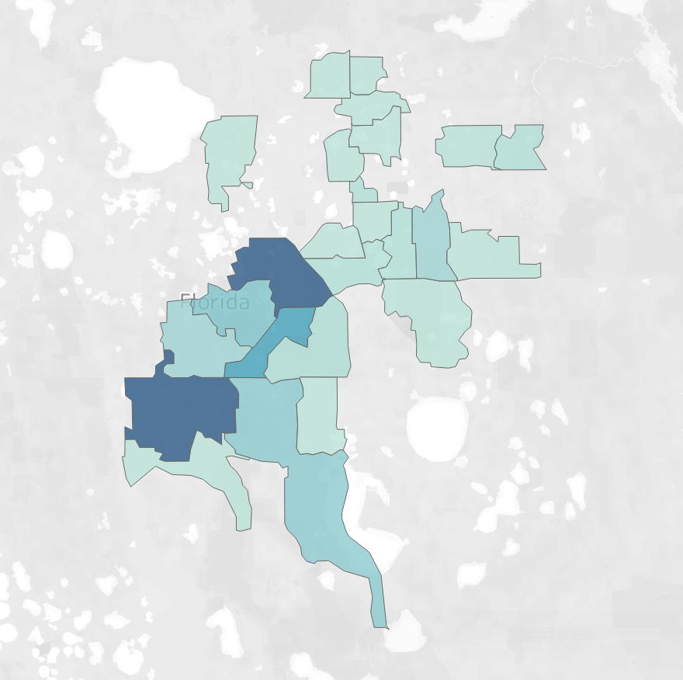
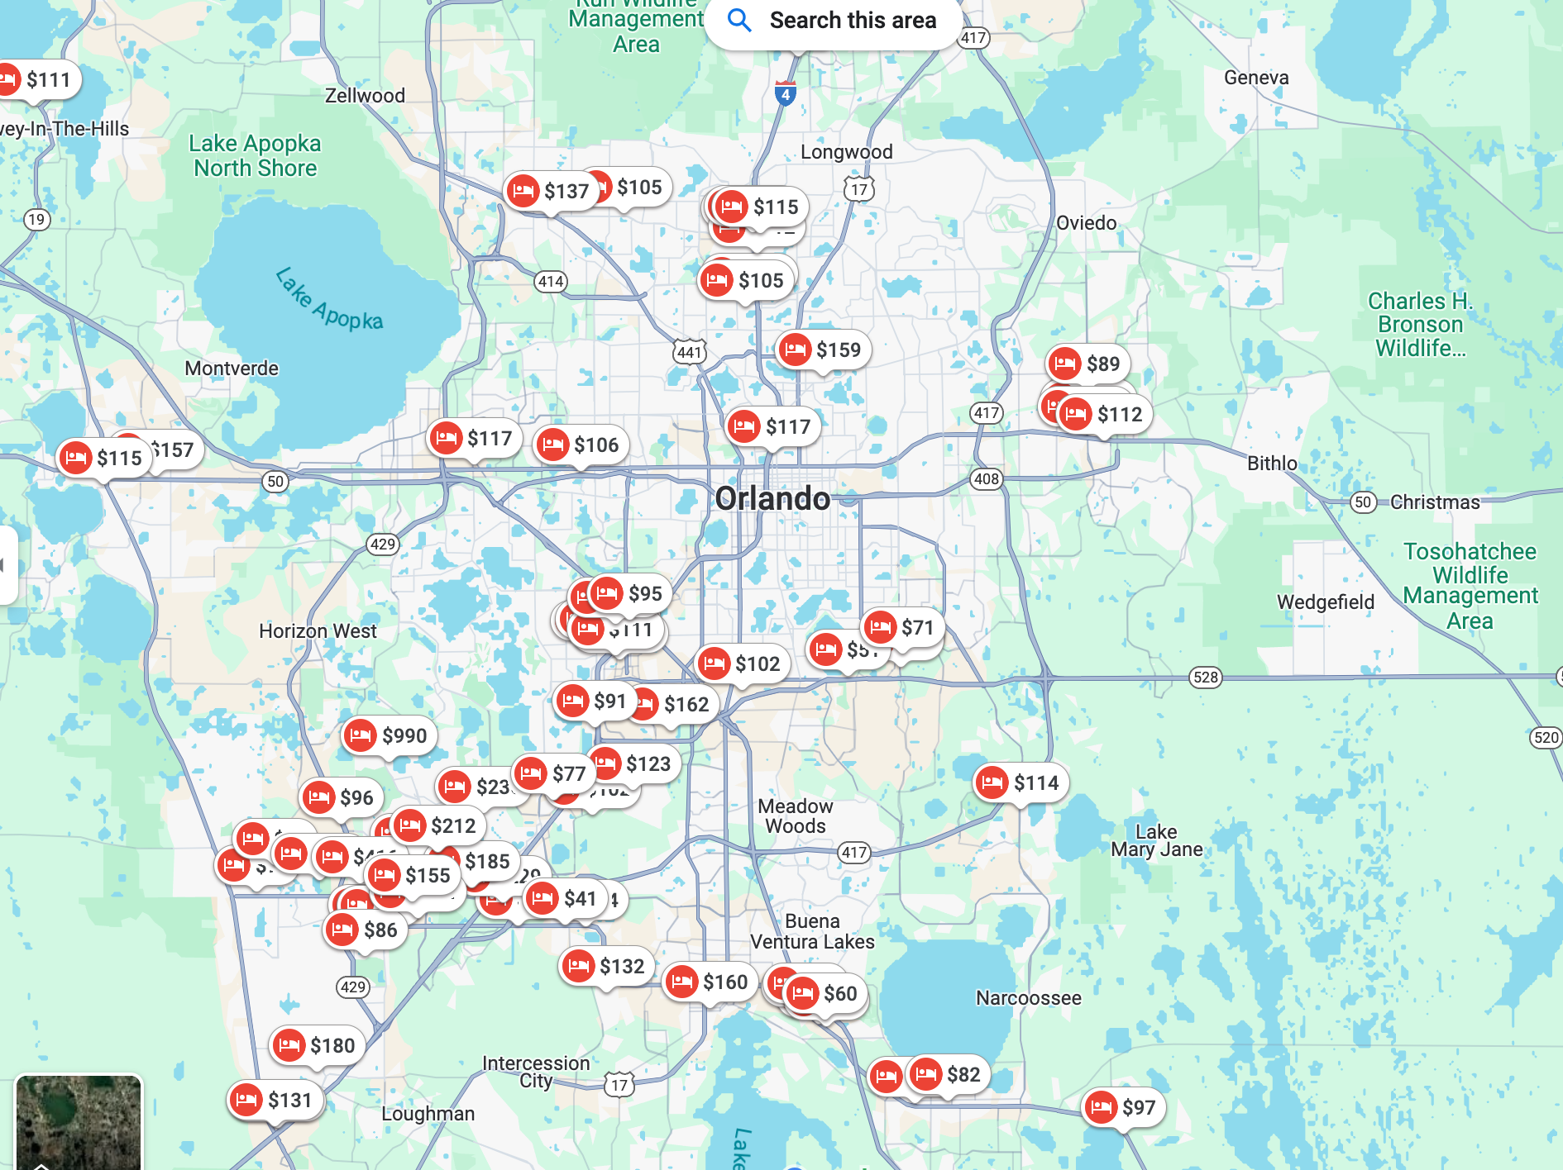
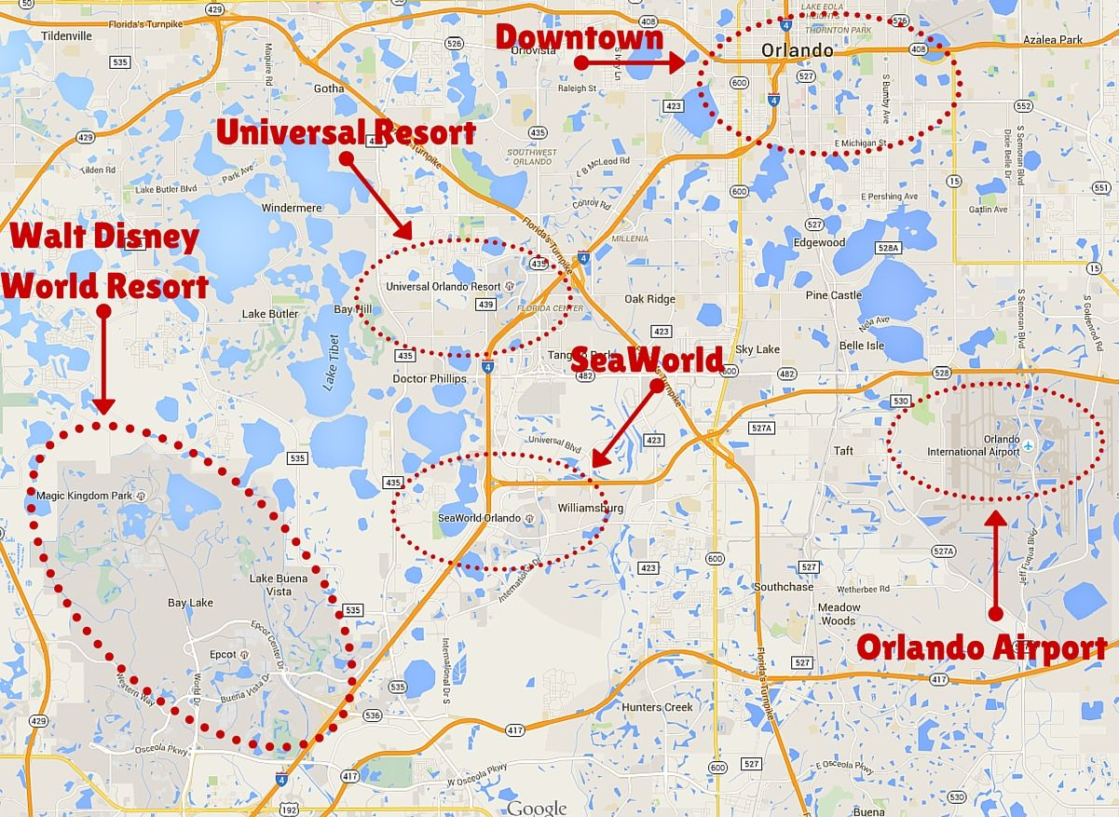
Evaluation Criteria Comparison
Hotel Distribution
Competitive Landscape (10%)
Number of Nearby Hotels (5%): Evaluate the density of competitors in the area.
Competitor Pricing (3%): Analyze average room rates of nearby hotels.
Competitor Amenities (2%): Review unique offerings from competitors.
Proximity to Theme Park Attractions (12%)
Distance to Major Parks (12%): Evaluate travel time to Disney, Universal, and other parks.
Granular Hotel Distribution
Theme Park Distribution
Notes:
SOCIAL MEDIA MARKETING
Social media feeds: Regularly repost guest photos and videos on your hotel's Instagram, Facebook, or TikTok accounts.
UGC:
Create Shareable Moments: Design Instagrammable spots within the hotel, such as themed rooms, unique decor, or stunning views.
Offer Incentives: Provide small rewards like discounts, complimentary drinks, or loyalty points for guests who share their stay on social media with a branded hashtag.
TAILOR MARKETING EFFORTS
Microtargeting: As businesses aim to personalize their marketing efforts, microtargeting has become a key trend in market research in Orlando. This strategy involves collecting detailed data to segment potential customers into smaller, more specific groups, allowing businesses to tailor their messaging and offerings to meet the unique needs of each segment. For example: international travelers can be further segmented to:
Cultural Explorers: Travelers from Europe or Asia seeking immersive experiences.
Market proximity to cultural landmarks, museums, and authentic local cuisine.
Budget-Conscious Backpackers: Younger international visitors looking for affordable stays.
Promote shared rooms, discounts for extended stays, and local transportation deals.
Luxury Travelers: High-income individuals seeking exclusivity and top-notch services.
Showcase high-end suites, concierge services, and private tours.
Frequent Business Travelers: Professionals who combine business and leisure (bleisure).
Highlight work-friendly amenities and quick access to key business districts.
Encourage Guests to Share Experiences
Create Shareable Moments: Design Instagrammable spots within the hotel, such as themed rooms, unique decor, or stunning views.
Offer Incentives: Provide small rewards like discounts, complimentary drinks, or loyalty points for guests who share their stay on social media with a branded hashtag.
Social Media Feeds: Regularly repost guest photos and videos on your hotel's Instagram, Facebook, or TikTok accounts.Highlight different experiences (e.g., dining, spa, pet-friendly features).
Website Integration: Display UGC galleries on your hotel’s website to show authentic guest experiences.Use tools like "Social Wall" to aggregate tagged posts.
Customer Experience Research
Social Media Listening:Monitor platforms like Twitter or Instagram for customer sentiment and feedback.
Touchpoint-Specific Surveys:Trigger surveys immediately after a customer interaction (e.g., after a hotel stay or call center interaction).
Identify gaps between customer expectations and actual experiences.
Installing kiosks (a small, self-service station or booth, typically equipped with a touchscreen, that allows customers to interact with a system to perform specific tasks) in physical locations(e.g., hotel lobby) allows customers to quickly rate their experience or answer specific questions.

Slide 13
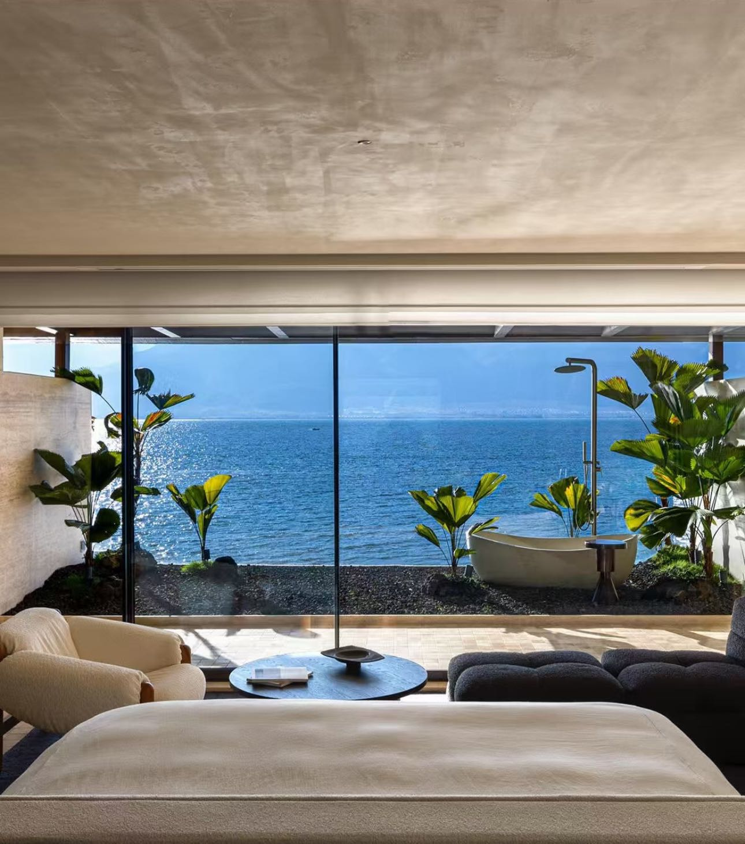
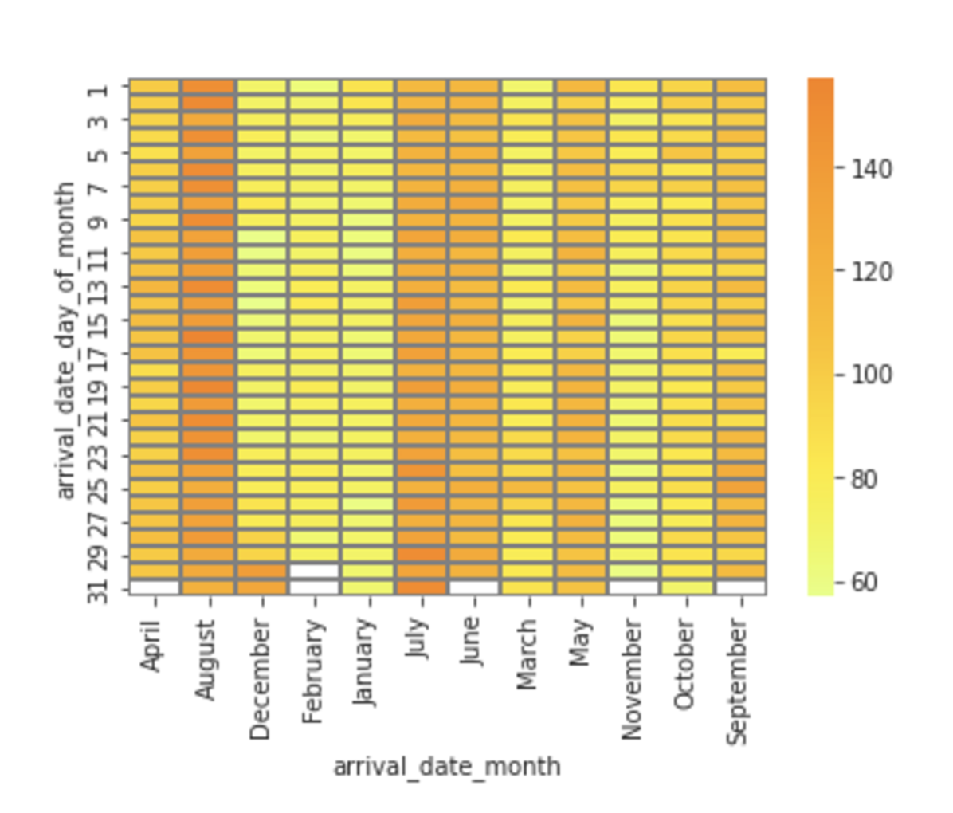
Seasonal Pricing Trend

Slide 14
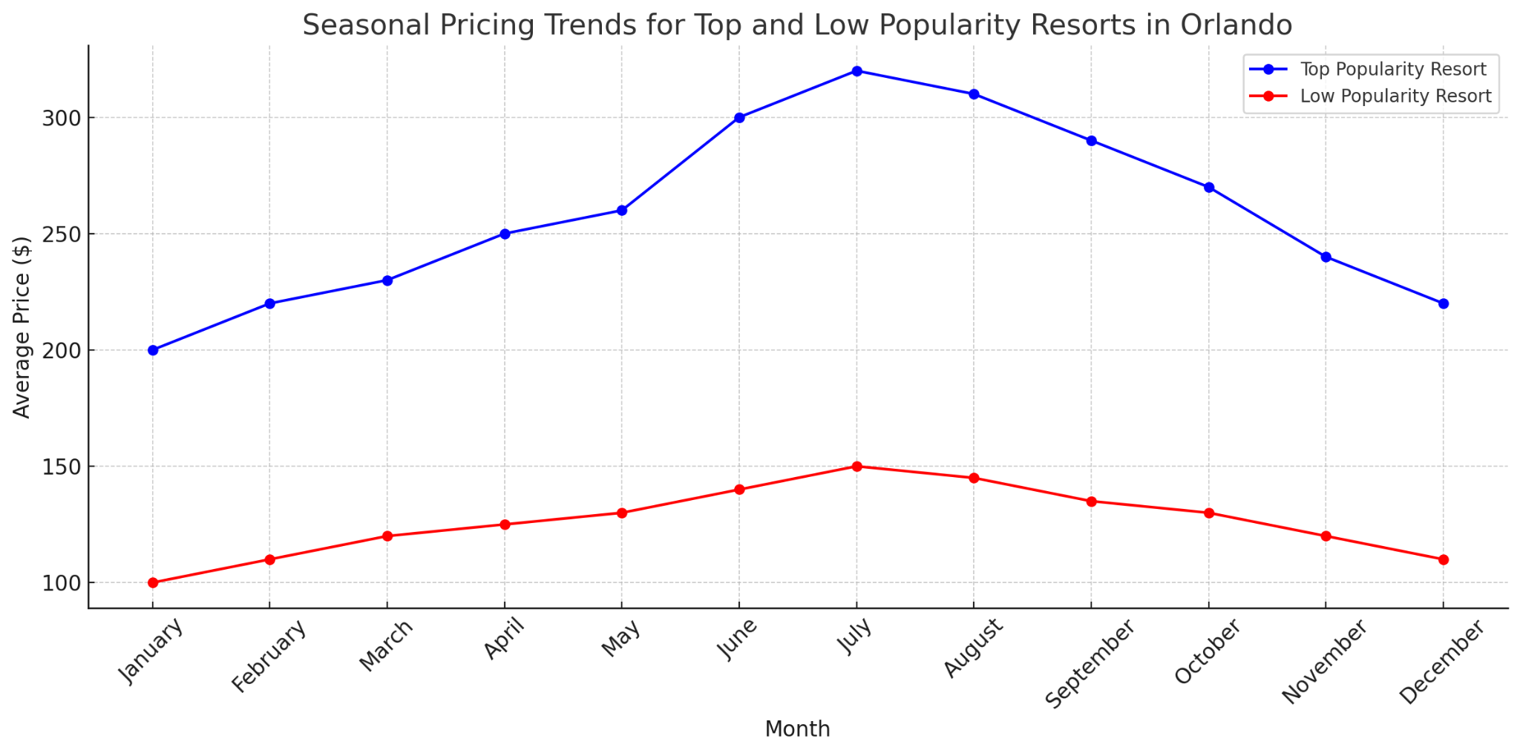
Seasonal Pricing Trend

Slide 15
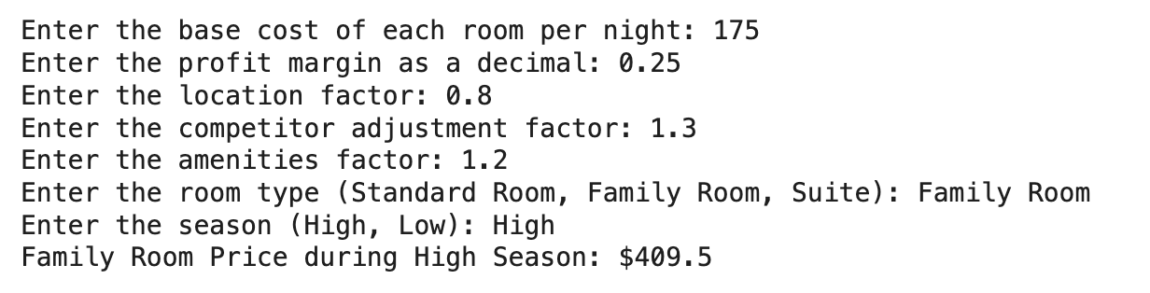
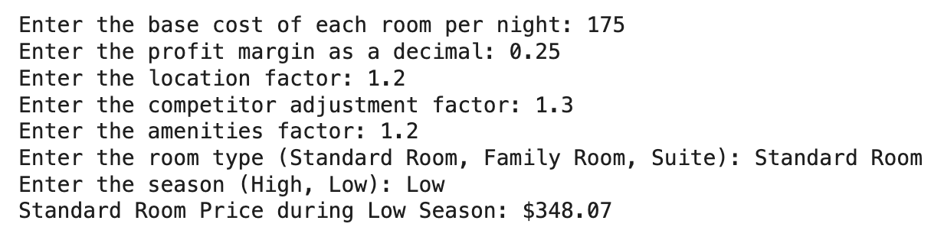
Pricing Strategy for Orlando Resort
Price=(Base Cost × (1+ Profit Margin)) × Location Factor × Competitor Adjustment Factor × Amenities Factor × Room Type × Season
Base Cost=(Number of Rooms×365×Average Occupancy Rate)(Employee Annual Salary×Number of Employees)+(Employee Annual Salary×Number of Employees×Percentage of Other Operating Costs)​=100×365×0.70)(40,000×80)+(40,000×80×0.40)≈175.42
Source: Wei et al., 2024. Price it High if it is Varied: Perceived Heterogeneity and the Effectiveness of Discount Framing Strategies for Travel Packages.
O'Neill and Quadri-Felitti, 2017. Resort Fees and Service Fees in the US Hotel Industry: Context and Concepts Related to Partitioned Pricing.
Notes:
We’ve developed a dynamic pricing model for our client resort. Our model consists of several critical variables that are drawn from related reports and articles, to ensure robustness. Within this model, Base Cost serves as the foundation. It is calculated by considering operational expenses. Such as how many employee and their salaries, and daily maintenance cost. For an average size of resort, the base cost is around 175 USD. Profit Margin is added to the base cost to ensure financial health, and for the hotel industry, profit margin is around 20%-30%. And within Orlando, if clients choose to set the resort close to Disney or Universal, the location factor would be higher than average. And the more spas, fine dining, and pools, the higher amenities factor could be. Also, price setting changes with room type and seasonality.
We then developed an algorithm that calculates price automatically. Two examples are shown, by adjusting location, room, and season, prices change, it’s very flexible, so you can see this model is ready for providing our clients with prices their resorts need.
Based on the visualization and pricing model, some recommendations could be provided for our clients. During peak and semi-peak seasons, instead of only raising prices, offer exclusive experiences like special dining packages or themed activities can add unique value to guests. In off-peak seasons, offering "extended stay", room upgrades or meal discounts can help boost bookings. This is also a good way for risk management.

Slide 16
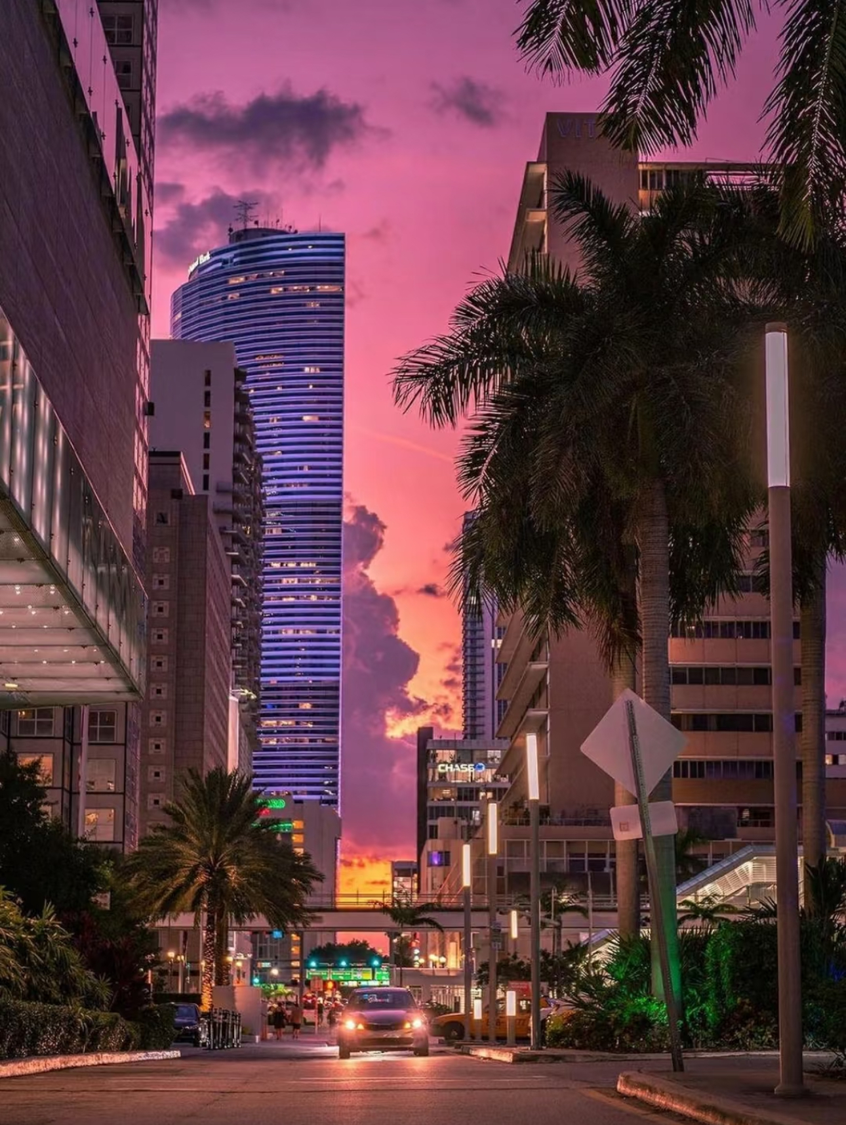
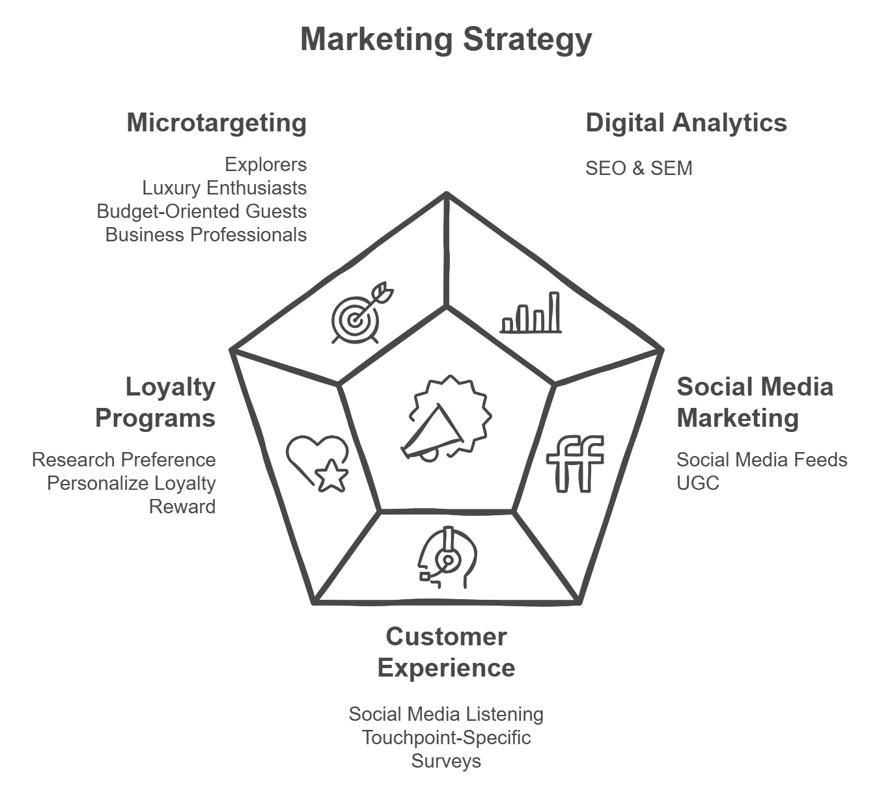
Marketing Analytics
Notes:
SOCIAL MEDIA MARKETING
Social media feeds: Regularly repost guest photos and videos on your hotel's Instagram, Facebook, or TikTok accounts.
UGC:
Create Shareable Moments: Design Instagrammable spots within the hotel, such as themed rooms, unique decor, or stunning views.
Offer Incentives: Provide small rewards like discounts, complimentary drinks, or loyalty points for guests who share their stay on social media with a branded hashtag.
TAILOR MARKETING EFFORTS
Microtargeting: As businesses aim to personalize their marketing efforts, microtargeting has become a key trend in market research in Orlando. This strategy involves collecting detailed data to segment potential customers into smaller, more specific groups, allowing businesses to tailor their messaging and offerings to meet the unique needs of each segment. For example: international travelers can be further segmented to:
Cultural Explorers: Travelers from Europe or Asia seeking immersive experiences.
Market proximity to cultural landmarks, museums, and authentic local cuisine.
Budget-Conscious Backpackers: Younger international visitors looking for affordable stays.
Promote shared rooms, discounts for extended stays, and local transportation deals.
Luxury Travelers: High-income individuals seeking exclusivity and top-notch services.
Showcase high-end suites, concierge services, and private tours.
Frequent Business Travelers: Professionals who combine business and leisure (bleisure).
Highlight work-friendly amenities and quick access to key business districts.
Encourage Guests to Share Experiences
Create Shareable Moments: Design Instagrammable spots within the hotel, such as themed rooms, unique decor, or stunning views.
Offer Incentives: Provide small rewards like discounts, complimentary drinks, or loyalty points for guests who share their stay on social media with a branded hashtag.
Social Media Feeds: Regularly repost guest photos and videos on your hotel's Instagram, Facebook, or TikTok accounts.Highlight different experiences (e.g., dining, spa, pet-friendly features).
Website Integration: Display UGC galleries on your hotel’s website to show authentic guest experiences.Use tools like "Social Wall" to aggregate tagged posts.
Customer Experience Research
Social Media Listening:Monitor platforms like Twitter or Instagram for customer sentiment and feedback.
Touchpoint-Specific Surveys:Trigger surveys immediately after a customer interaction (e.g., after a hotel stay or call center interaction).
Identify gaps between customer expectations and actual experiences.
Installing kiosks (a small, self-service station or booth, typically equipped with a touchscreen, that allows customers to interact with a system to perform specific tasks) in physical locations(e.g., hotel lobby) allows customers to quickly rate their experience or answer specific questions.

Slide 17
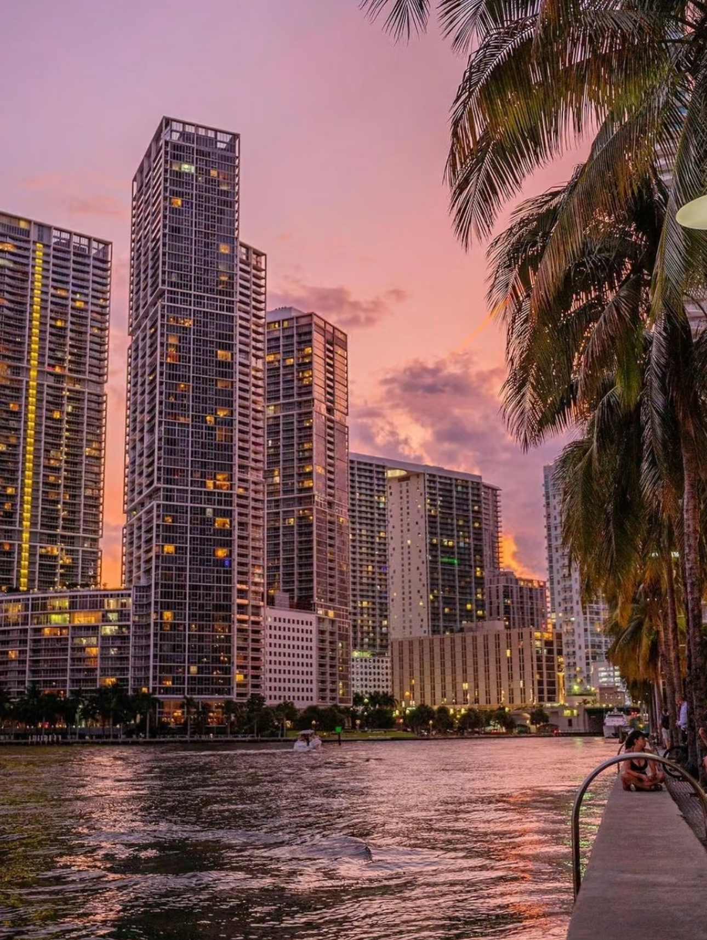
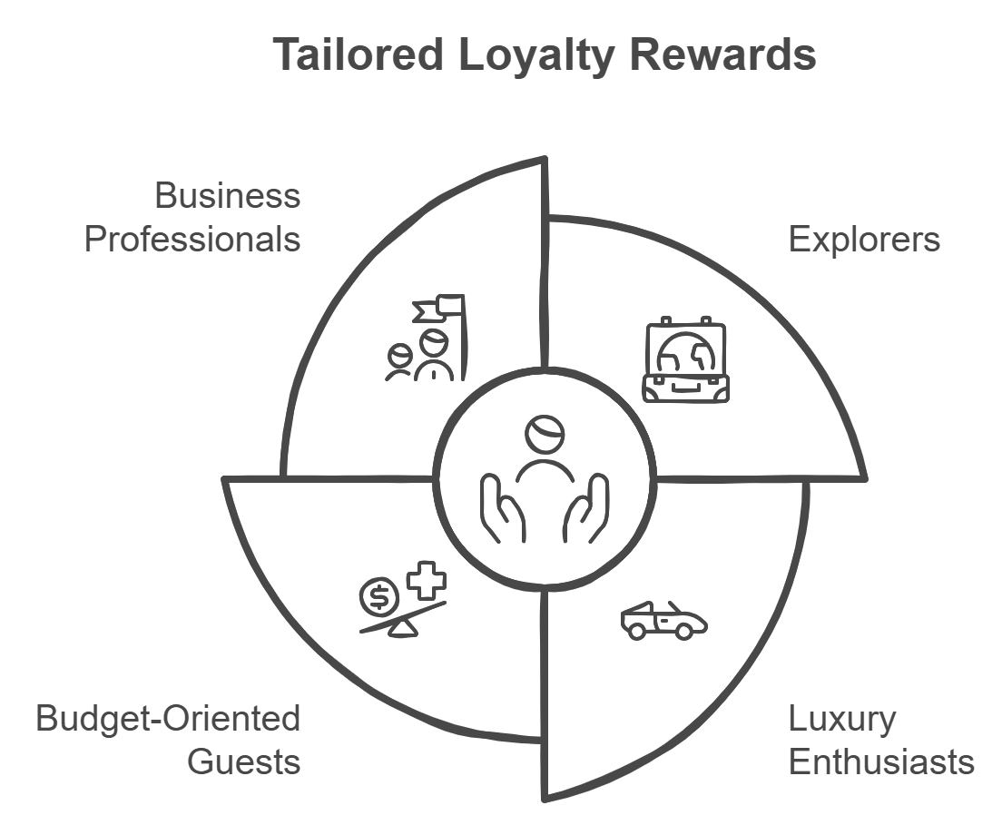
What loyalty rewards should be offered to different customer segments

Slide 18
THANK YOU!
Team 8
Xingzhu Chen
Wenxin Liang
Yanxu Yang
Shuomeng Guan
Notes:
SOCIAL MEDIA MARKETING
Social media feeds: Regularly repost guest photos and videos on your hotel's Instagram, Facebook, or TikTok accounts.
UGC:
Create Shareable Moments: Design Instagrammable spots within the hotel, such as themed rooms, unique decor, or stunning views.
Offer Incentives: Provide small rewards like discounts, complimentary drinks, or loyalty points for guests who share their stay on social media with a branded hashtag.
TAILOR MARKETING EFFORTS
Microtargeting: As businesses aim to personalize their marketing efforts, microtargeting has become a key trend in market research in Orlando. This strategy involves collecting detailed data to segment potential customers into smaller, more specific groups, allowing businesses to tailor their messaging and offerings to meet the unique needs of each segment. For example: international travelers can be further segmented to:
Cultural Explorers: Travelers from Europe or Asia seeking immersive experiences.
Market proximity to cultural landmarks, museums, and authentic local cuisine.
Budget-Conscious Backpackers: Younger international visitors looking for affordable stays.
Promote shared rooms, discounts for extended stays, and local transportation deals.
Luxury Travelers: High-income individuals seeking exclusivity and top-notch services.
Showcase high-end suites, concierge services, and private tours.
Frequent Business Travelers: Professionals who combine business and leisure (bleisure).
Highlight work-friendly amenities and quick access to key business districts.
Encourage Guests to Share Experiences
Create Shareable Moments: Design Instagrammable spots within the hotel, such as themed rooms, unique decor, or stunning views.
Offer Incentives: Provide small rewards like discounts, complimentary drinks, or loyalty points for guests who share their stay on social media with a branded hashtag.
Social Media Feeds: Regularly repost guest photos and videos on your hotel's Instagram, Facebook, or TikTok accounts.Highlight different experiences (e.g., dining, spa, pet-friendly features).
Website Integration: Display UGC galleries on your hotel’s website to show authentic guest experiences.Use tools like "Social Wall" to aggregate tagged posts.
Customer Experience Research
Social Media Listening:Monitor platforms like Twitter or Instagram for customer sentiment and feedback.
Touchpoint-Specific Surveys:Trigger surveys immediately after a customer interaction (e.g., after a hotel stay or call center interaction).
Identify gaps between customer expectations and actual experiences.
Installing kiosks (a small, self-service station or booth, typically equipped with a touchscreen, that allows customers to interact with a system to perform specific tasks) in physical locations(e.g., hotel lobby) allows customers to quickly rate their experience or answer specific questions.

